Slide 1
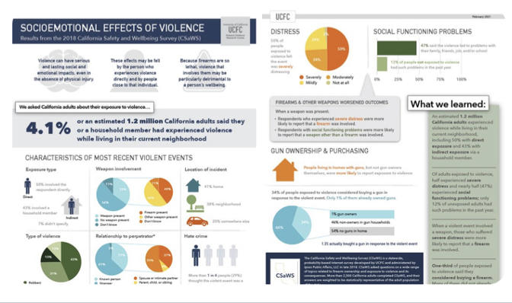
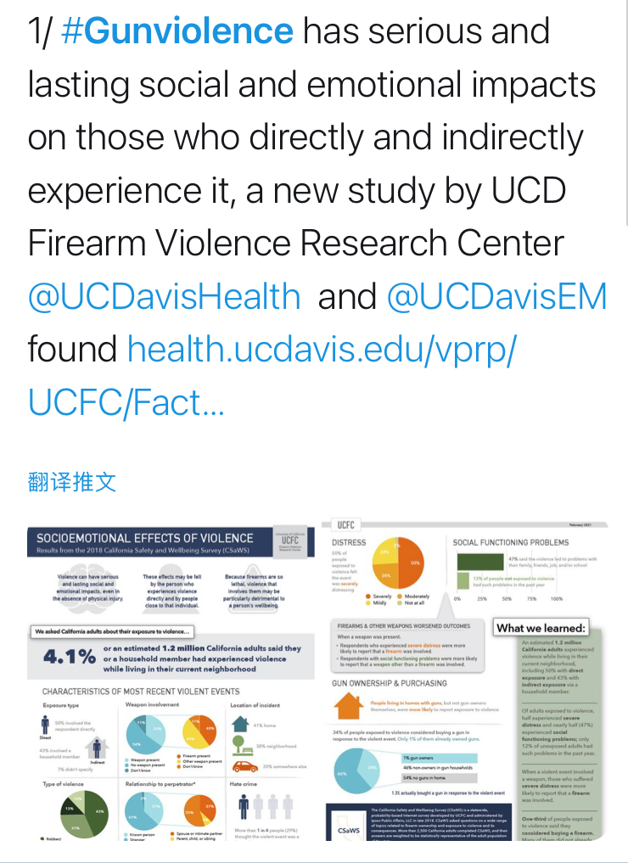
Topic: Gun Control Stance: Support
[claim]
[premise]
[informative]

Slide 2
#Gunviolence has serious and lasting social and emotional impacts on those who directly and indirectly experience it, a new study by UCD Firearm Violence Research Center @UCDavisHealth and @UCDavisEM found health.ucdavis.edu/vprp/UCFC/Fact
(a) A posted tweet text
(b) An associated posted tweet image

Slide 4
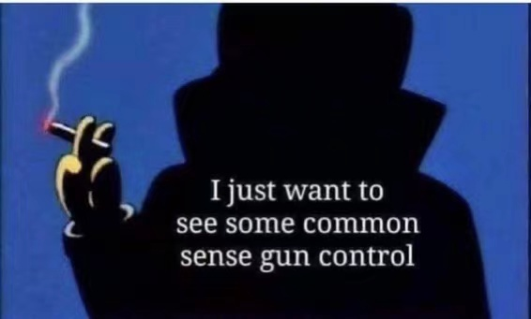
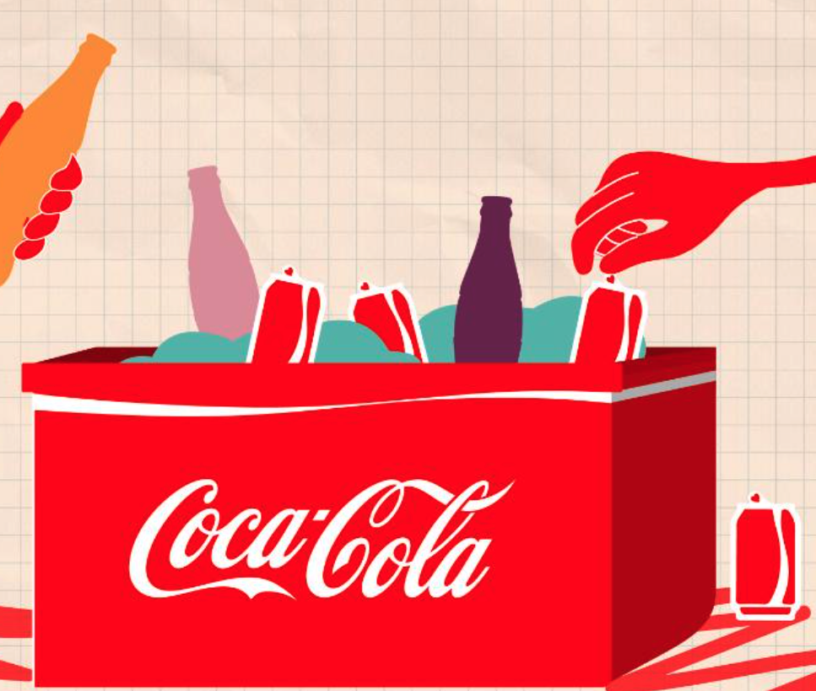

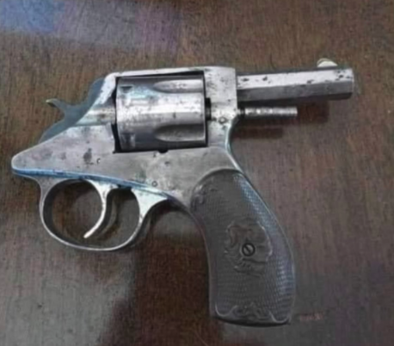
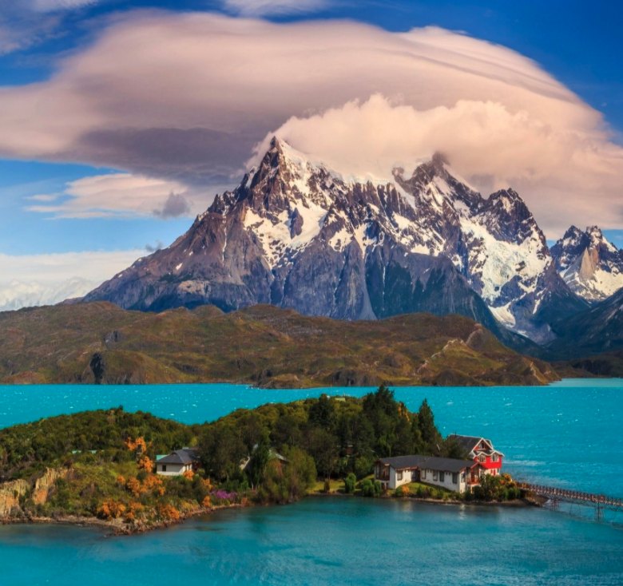
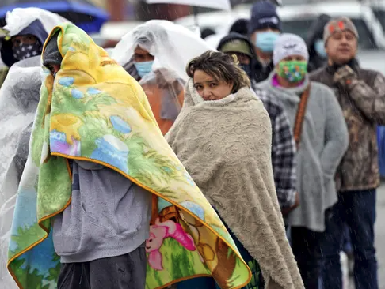
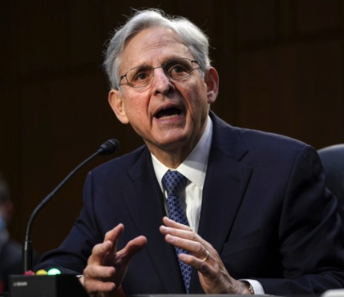
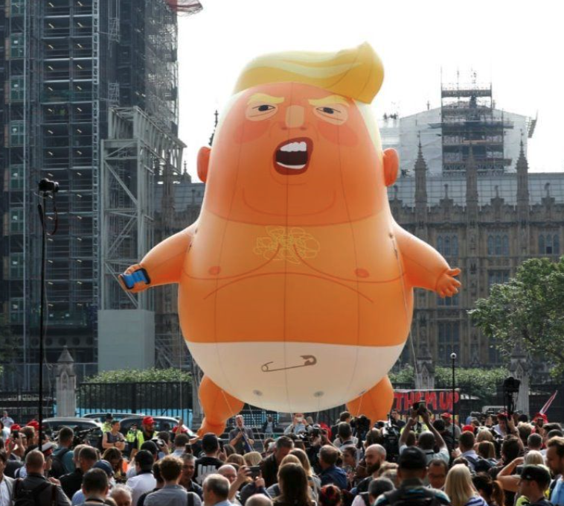

Twitter: If the thousand of gun control laws now aren't enough, they never will be…
Slogan: contain argumentative slogans
Twitter: Gun violence has serious and lasting social and emotional impacts on those…
Informative: provide context related information
Twitter: The current administrations answer for Gun control…
Ironic: express ironic emotion or arguments
Twitter: Biden AG pick Merrick Garland says there's room for new gun control.
No-argumentative: no argumentative information

Slide 5
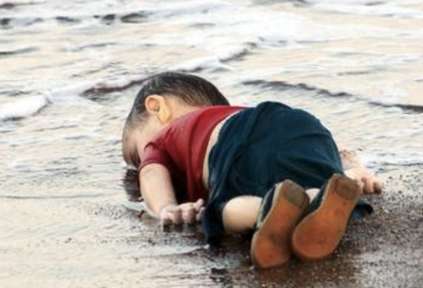
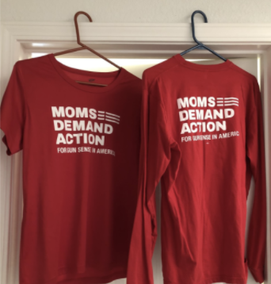
Twitter: How could we close our door to refugees…
Emotional: the image incites reader’s some emotion
Twitter: Gun violence has serious and lasting social and emotional impacts on those…
Informative: provide context related information
Twitter: The current administrations answer for Gun control…
Rhetoric: express ironic point of views based on texts
Twitter: go for “@MomDema”…, making sure life-saving gun violence prevention is a priority in California!
Emphasis: Emphasize the “@MomDemand”

Slide 6
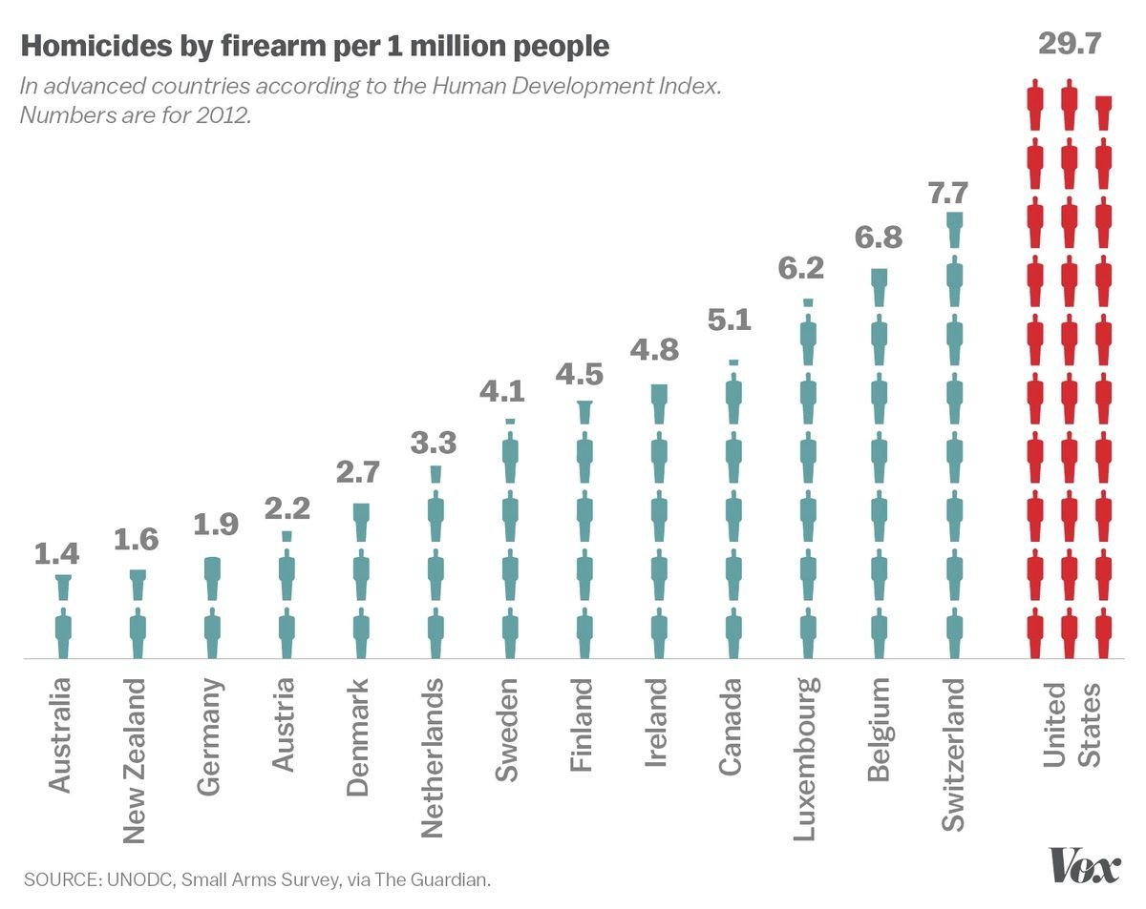
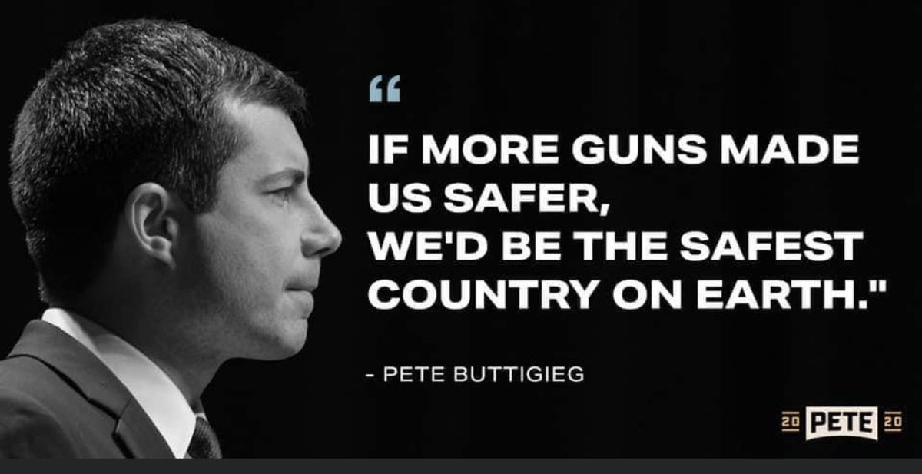
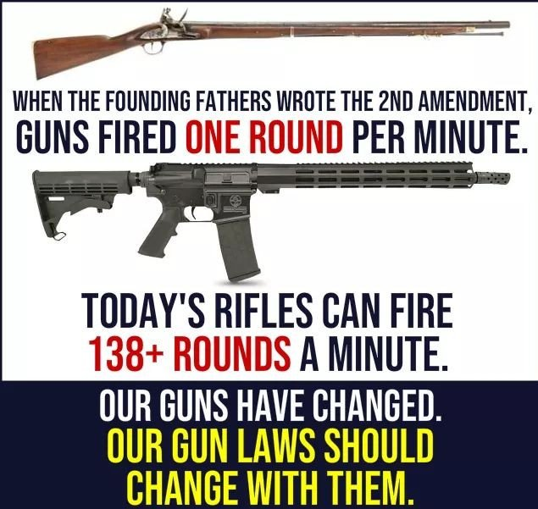
Statistics: Compared to other developed countries the US suffers from higher gun fatalities than many other countries it has a more than 3 times the amount of deaths
Testimony: Nobody NEEDS to own an assault rifle. #BanAssaultWeapons #GunViolence #GunReformNow #BoulderMassacre
Anecdote: Keep your guns but reform the #laws. During the founding fathers days #Guns were needed for protecting, hunting etc they didnt have to worry about

Slide 7
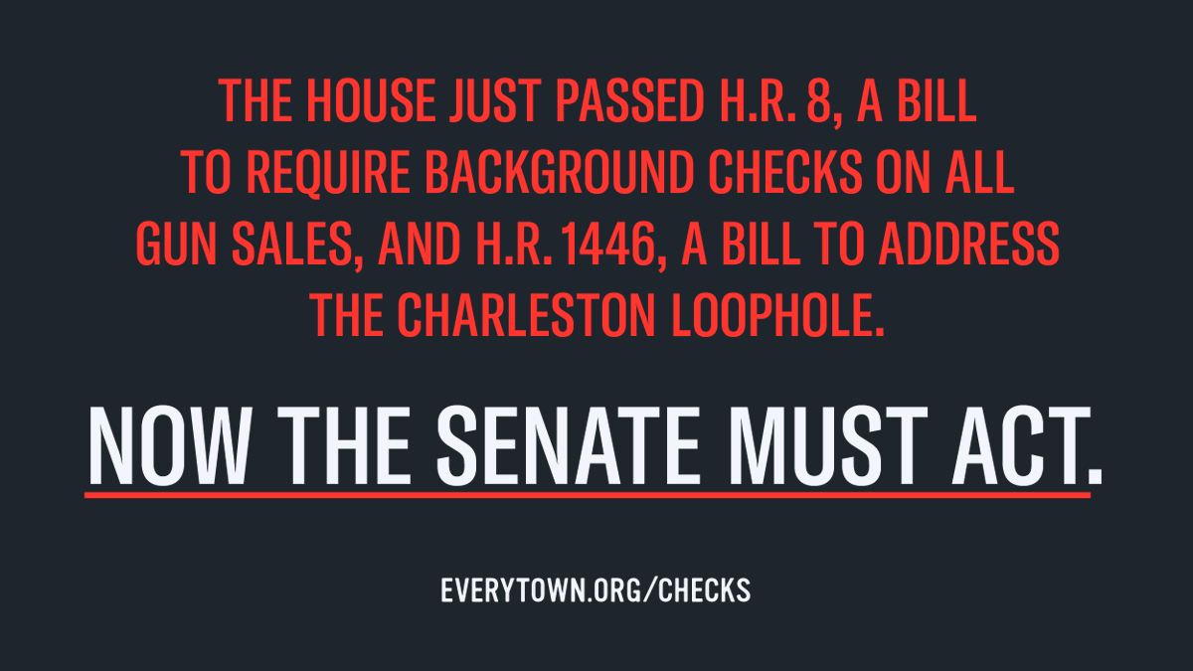
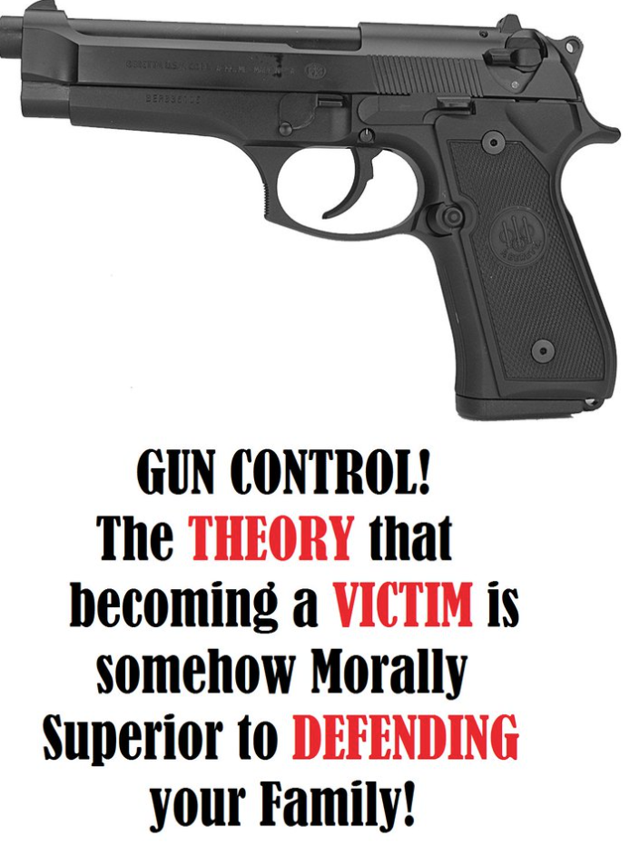
Support: ANOTHER BIG WIN FOR GUN SAFETY! Just after passing a bill to require background checks on all gun sales #HR8 the U.S House just passed #HR1446, a bill that would address the deadly Charleston loophole. This bill now heads to the Senate.
Oppose: #GunControl The THEORY that becoming a VICTIM is somehow morally superior to DEFENDING yourself or family! We support #SelfDefence #Legalgunownership #SafeCitizen

Slide 8
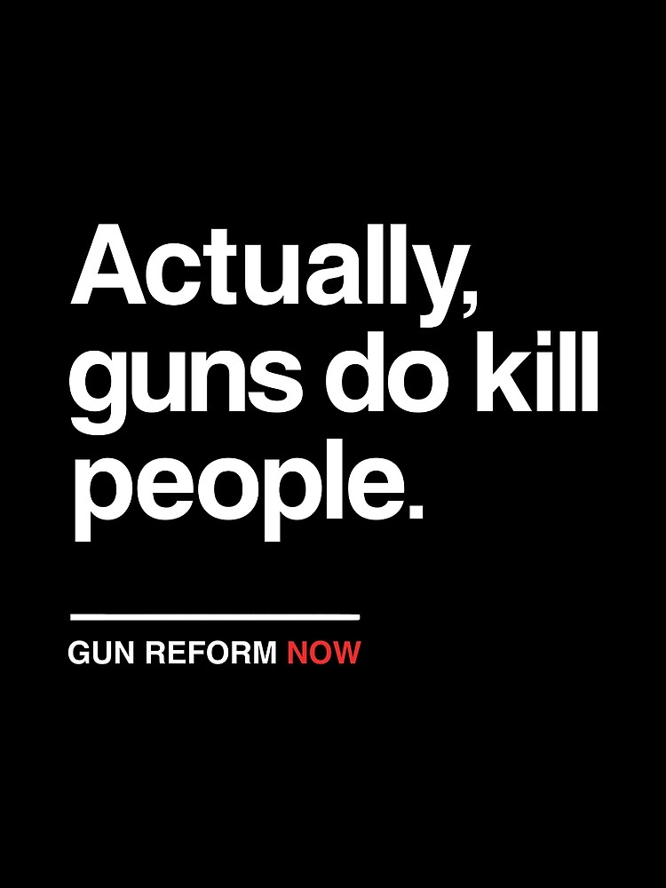
Anecdote: Keep your guns but reform the #laws. During the founding fathers days #Guns were needed for protecting, hunting etc they didnt have to worry about
Slogan: New research shows that the US has so much #gunViolence because of GUNS! Make our country safer for everyone. Demand #GunControlNow #EnoughIsEnough

Slide 9

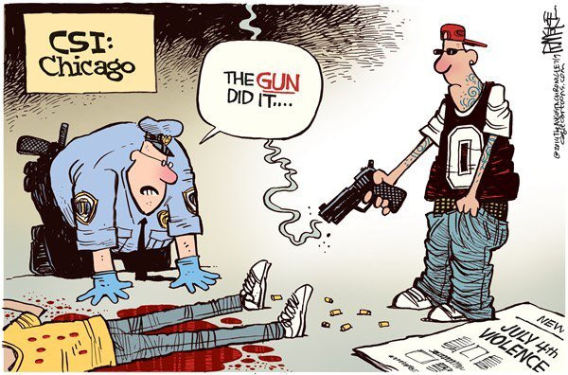
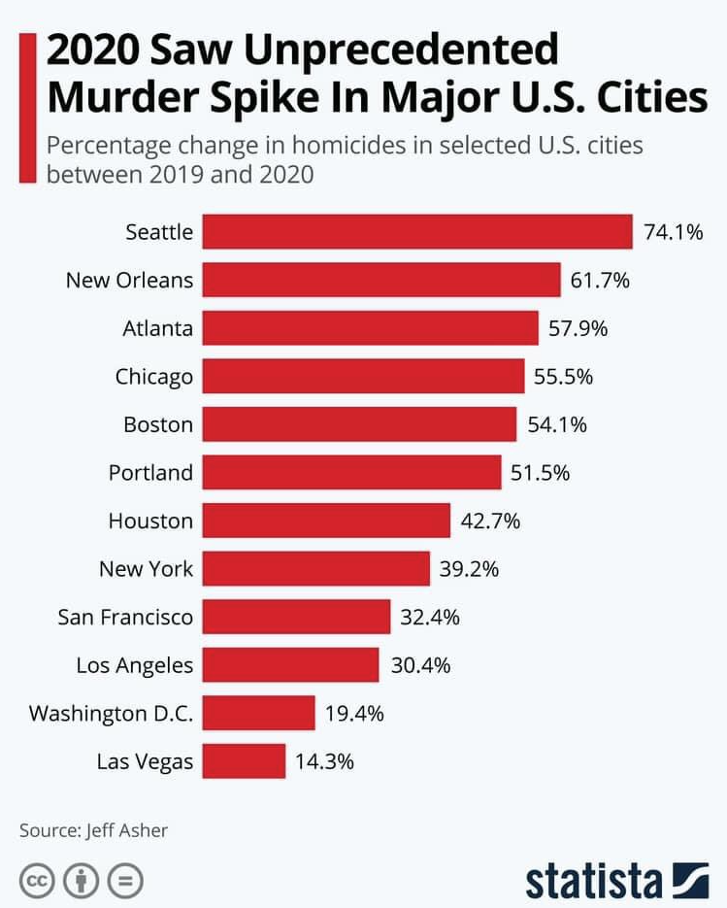
Image Persuasiveness Score = 0.0
You know, if you really wanted to end gun violence you could focus on mental health instead of gun control restrictions that don’t actually prevent mentally unstable people from obtaining guns illegally
Image Persuasiveness Score = 0.6
It’s not the gun. It’s the operator. Gun control including gun bans does not deter the bad behaviour of willful miscreants from acquiring guns and committing violent crime. Gun control is not crime control
Image Persuasiveness Score = 1.2
Unfortunately, common people don’t have the luxury to use military and law enforcement protection like the politicians do in DC today. Most of these high murder rate cities have the strictest gun control laws so citizens can’t easily arm themselves

Slide 10
Image Persuasiveness Score = 0.0
Image Persuasiveness Score = 0.6
Image Persuasiveness Score = 1.2
You know, if you really wanted to end gun violence you could focus on mental health instead of gun control restrictions that don’t actually prevent mentally unstable people from obtaining guns illegally
It’s not the gun. It’s the operator. Gun control including gun bans does not deter the bad behaviour of willful miscreants from acquiring guns and committing violent crime. Gun control is not crime control
Unfortunately, common people don’t have the luxury to use military and law enforcement protection like the politicians do in DC today. Most of these high murder rate cities have the strictest gun control laws so citizens can’t easily arm themselves

Slide 11
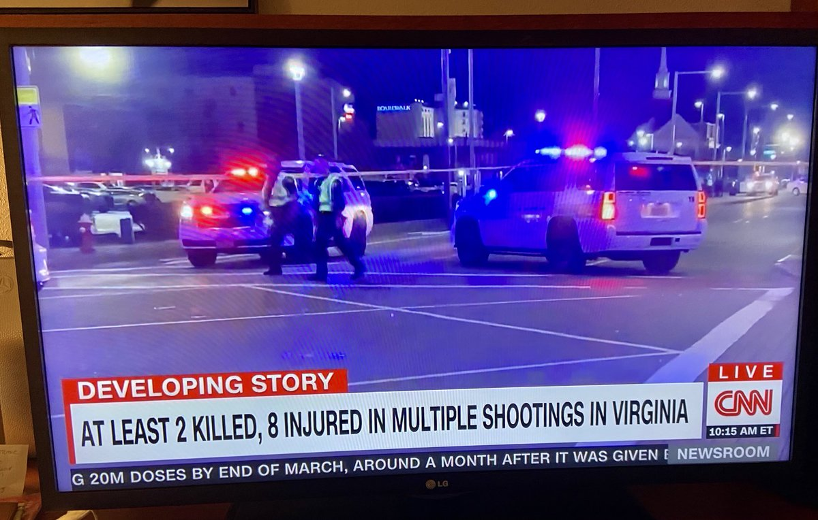
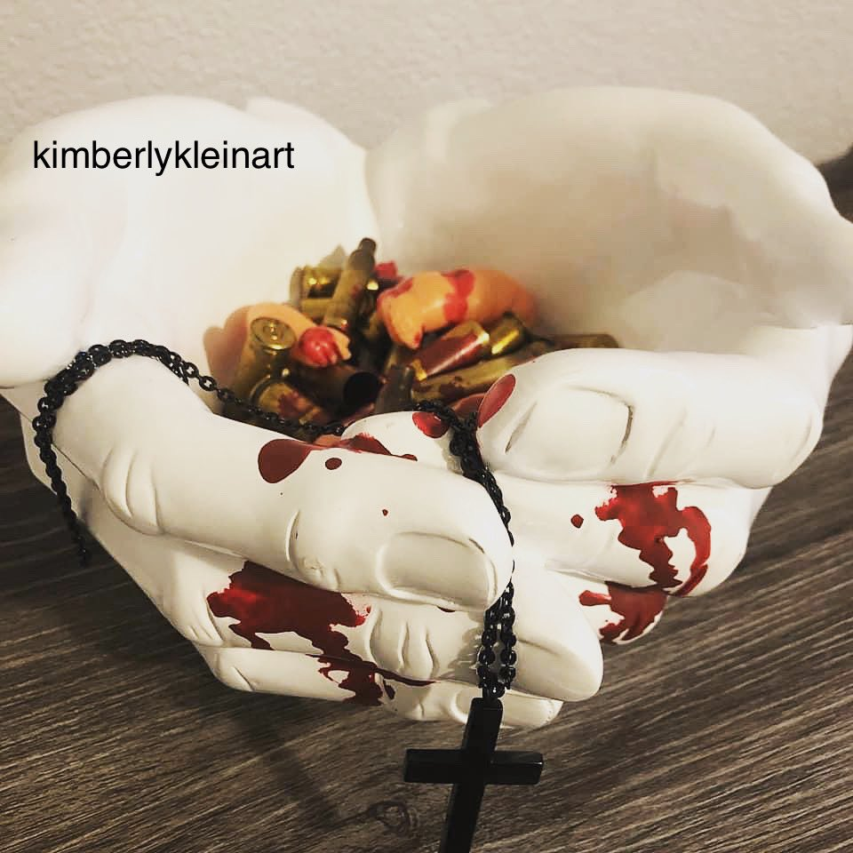
Slogan: New research shows that the US has so much #gunViolence because of GUNS! Make our country safer for everyone. Demand #GunControlNow
Scene photo: America has a #GunViolence problem the manufacturers make money hand over fist, funnel millions into the #GOP and we lose lives
Symbolic: Thanks for all your 201cThoughts and Prayers. They are saving lives right and left. Clearly. #GunControlNow #BoulderStrong #GunViolence

Slide 12
Statistics: Compared to other developed countries the US suffers from higher gun fatalities than many other countries it has a more than 3 times the amount of deaths
Testimony: Nobody NEEDS to own an assault rifle. #BanAssaultWeapons #GunViolence #GunReformNow #BoulderMassacre

Slide 13
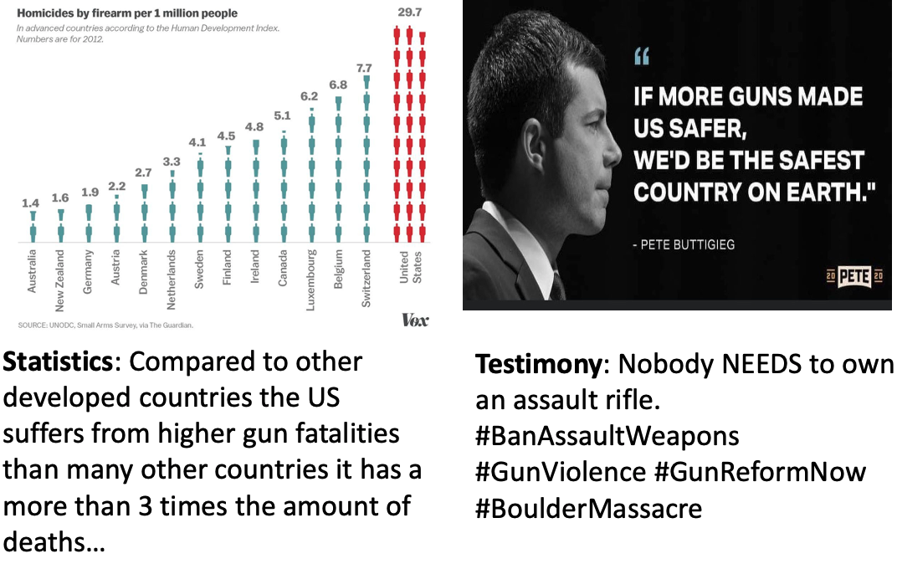
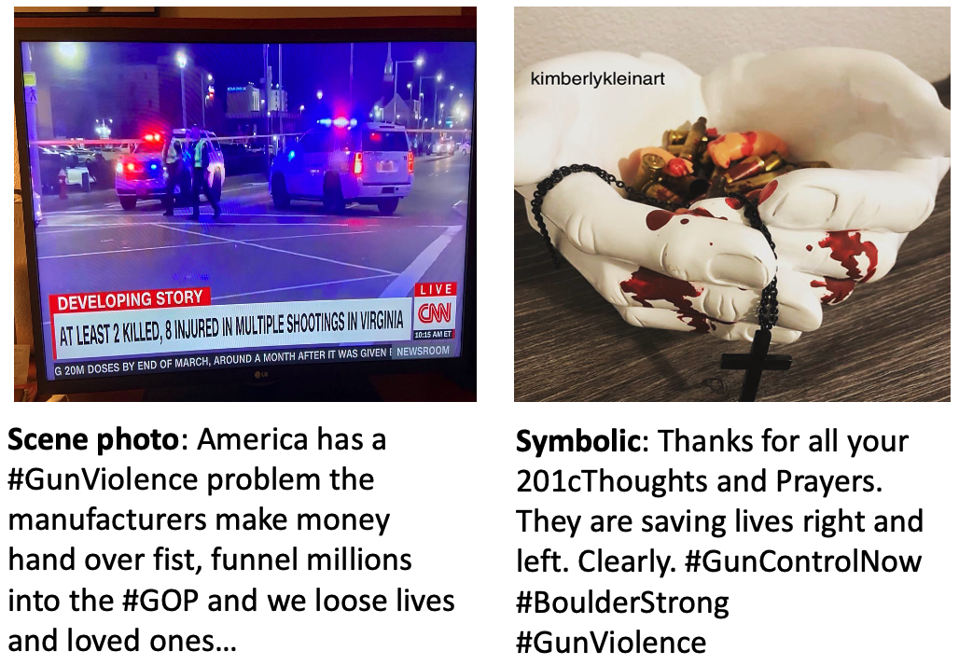
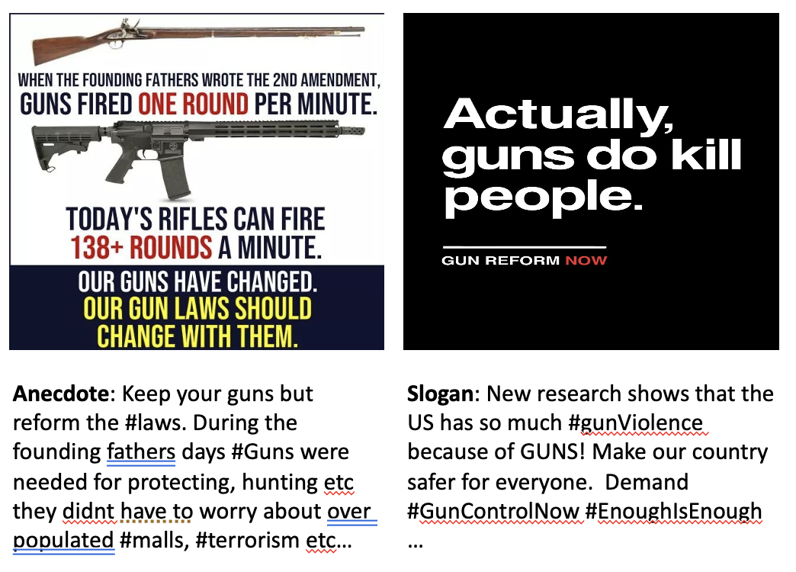
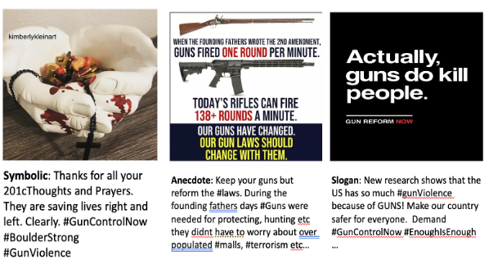
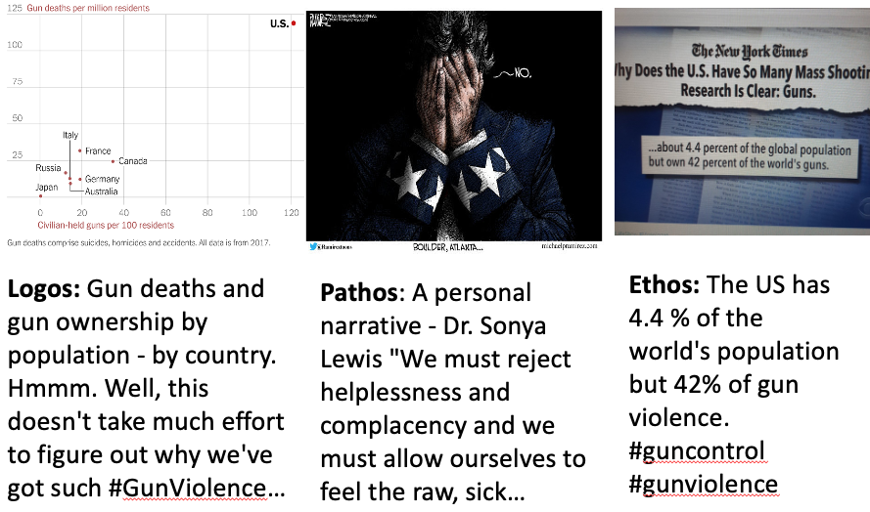

Slide 14
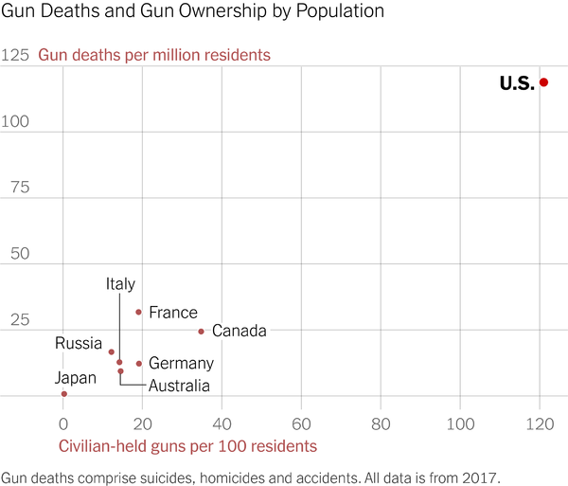
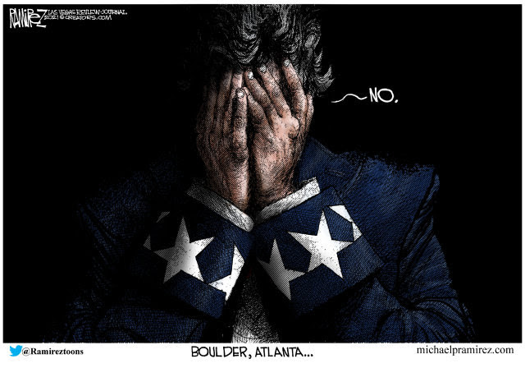
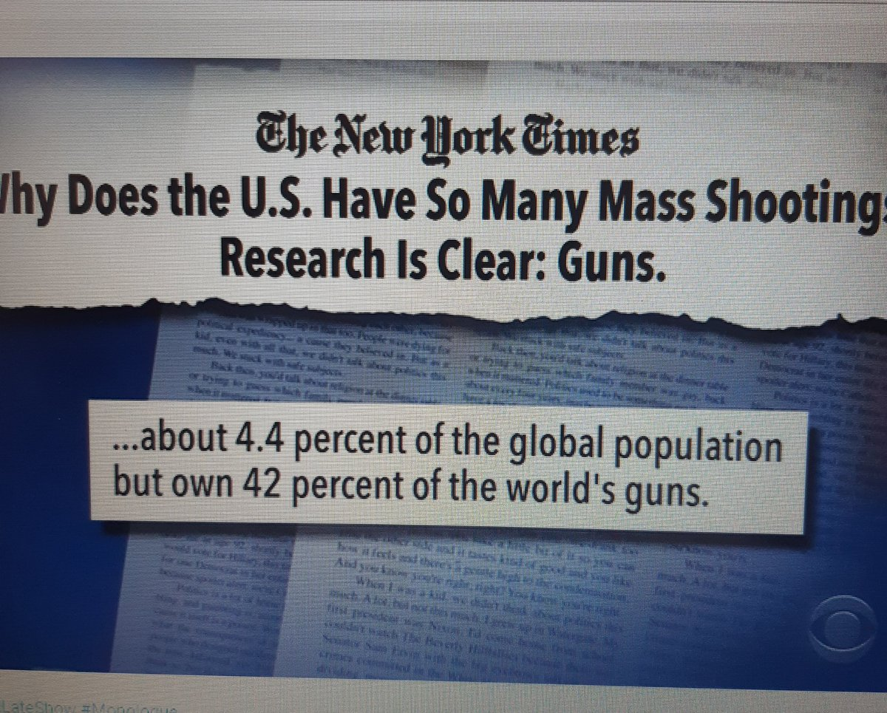
Logos: Gun deaths and gun ownership by population - by country. Hmmm. Well, this doesn't take much effort to figure out why we've got such #GunViolence…
Pathos: A personal narrative - Dr. Sonya Lewis "We must reject helplessness and complacency and we must allow ourselves to feel the raw, sick…
Ethos: The US has 4.4 % of the world's population but 42% of gun violence. #guncontrol #gunviolence

Slide 15
Logos: Gun deaths and gun ownership by population - by country. Hmmm. Well, this doesn't take much effort to figure out why we've got such #GunViolence…
Pathos: A personal narrative - Dr. Sonya Lewis “We must reject helplessness and complacency and we must allow ourselves to feel the raw, sick”
Ethos: The US has 4.4 % of the world's population but 42% of gun violence. #guncontrol #gunviolence

Slide 16
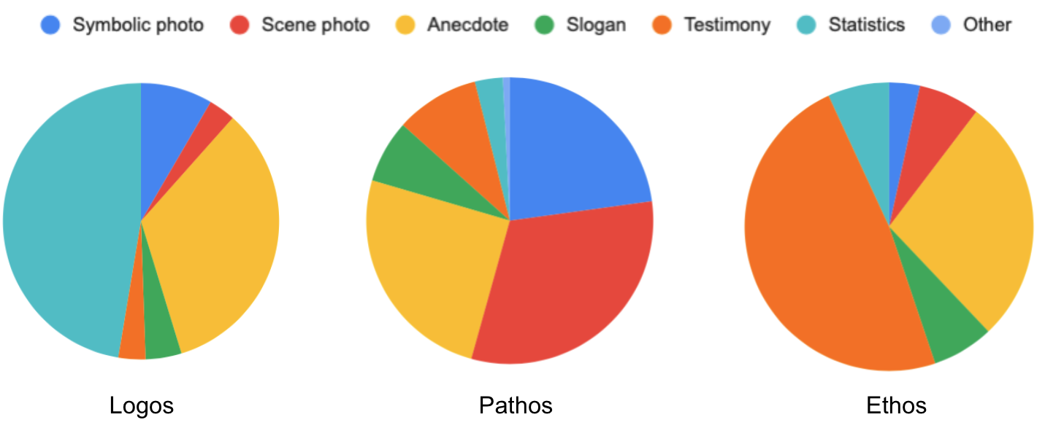
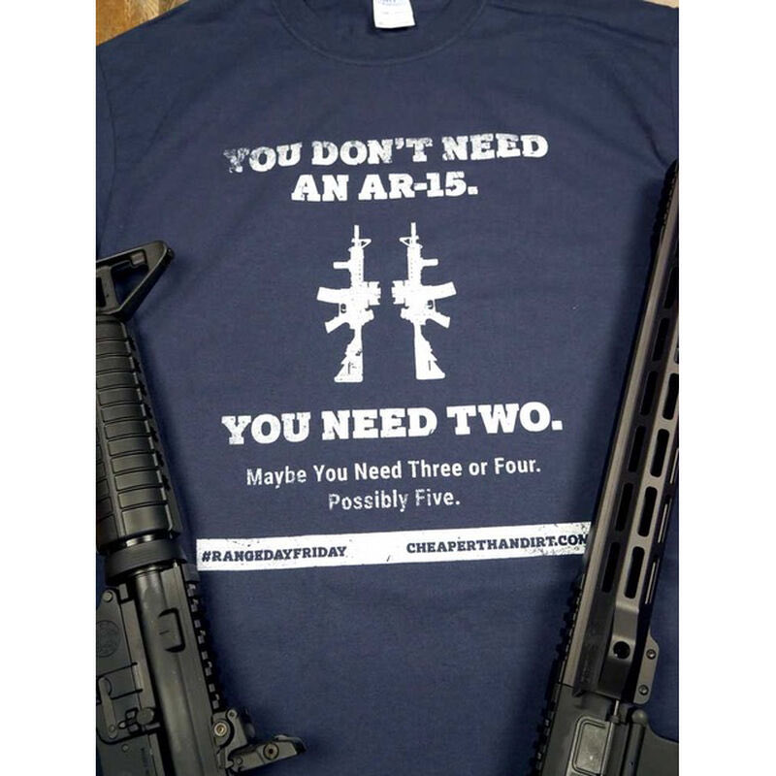
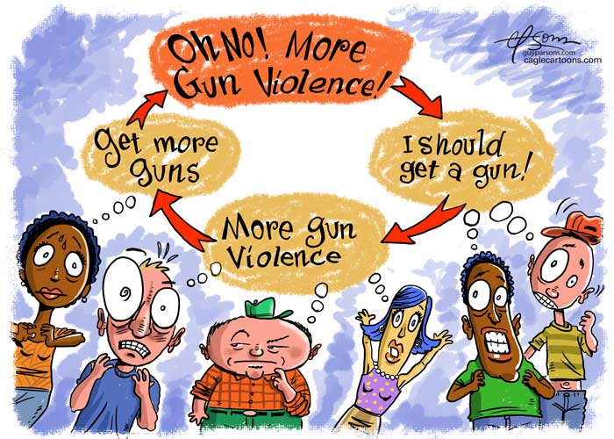
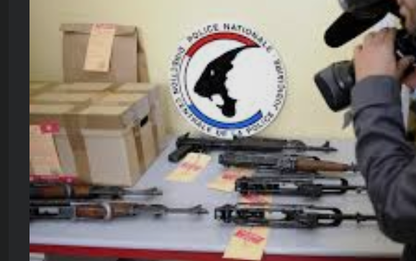
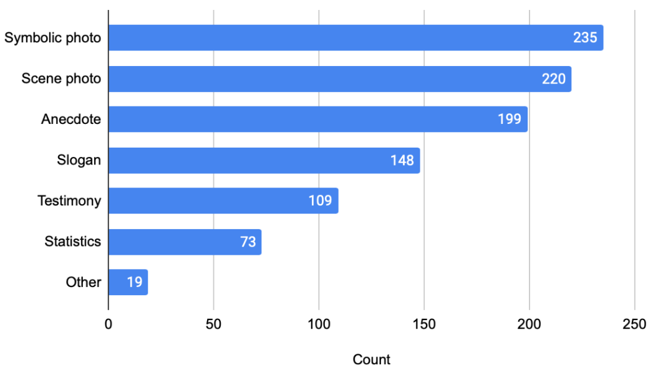
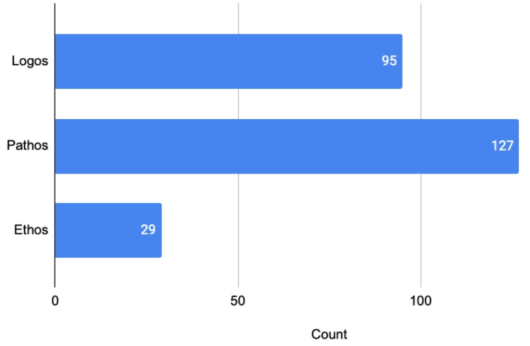
Probability 0.799
Probability 0.796
Probability 0.775
Today is the 8th anniversary of #SandyHook where 20 year old Adam Lanza killed 20 children and six teachers at Sandy Hook Elementary School before killing himself. Gun control, school safety, ending violence against children and preventing bullying matter.

Slide 17
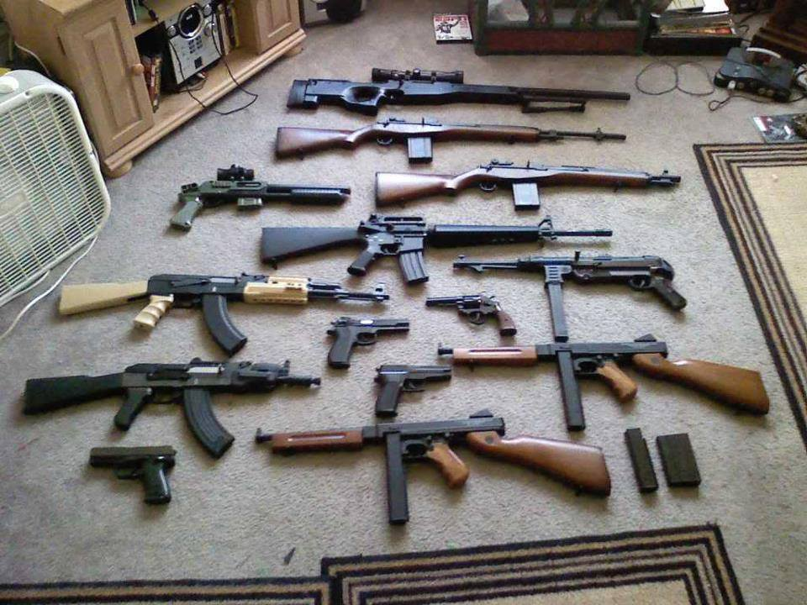
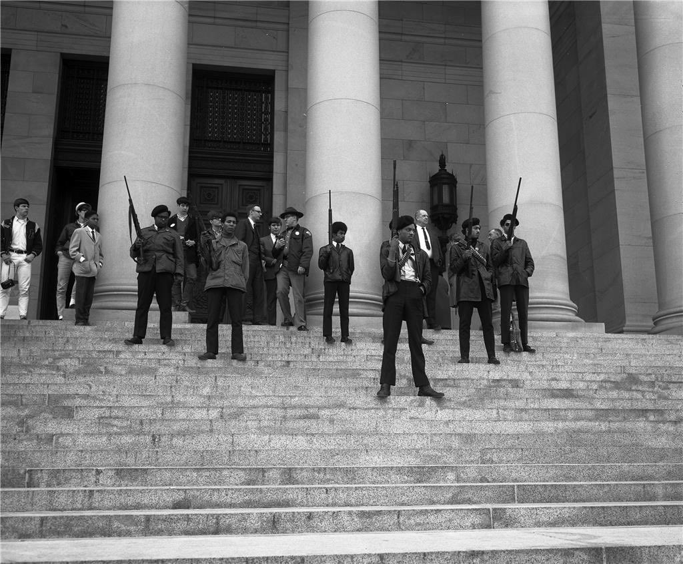
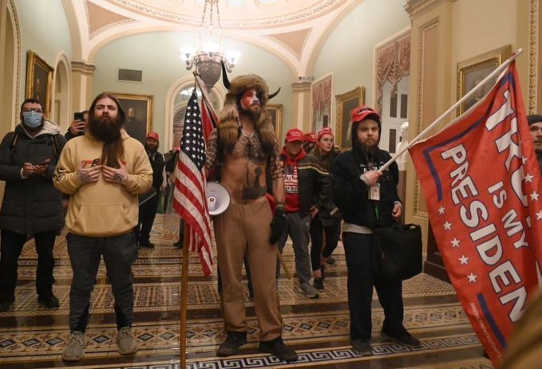


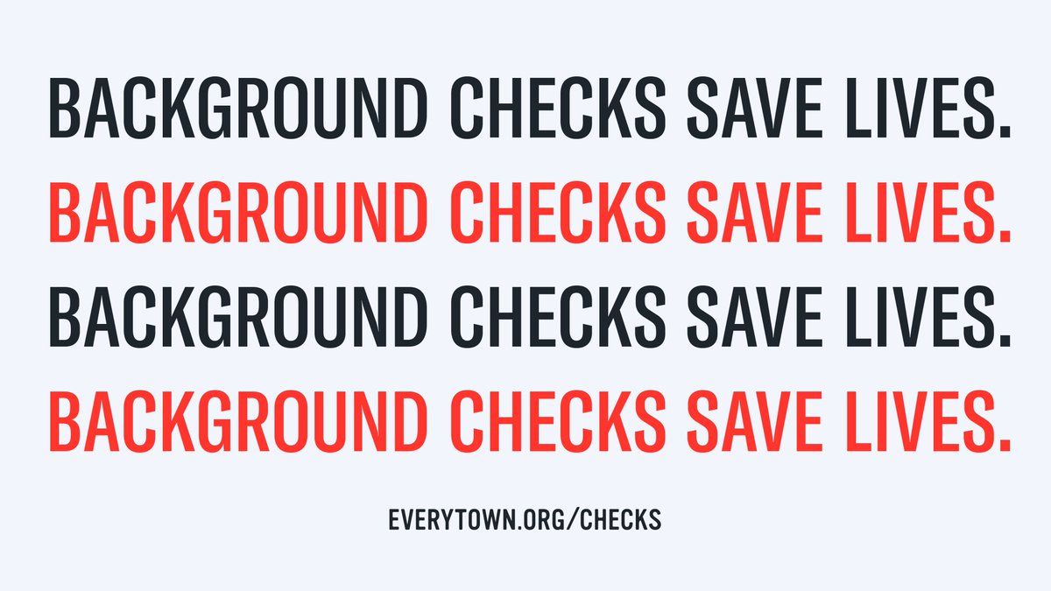
Every day, 100 people are shot and killed. 40,000 are killed each year. But Judge Barrett would rule to gut both our gun safety laws and our access to healthcare. We don't need a reckless, undemocratic nominee who threatens our livelihoods! #WeDissent #BlockBarrett
(a) Persuasive Score: 0.684
(b) Persuasive Score: 0.674
(c) Persuasive Score: 0.668
(d) Persuasive Score: 0.345
(e) Persuasive Score: 0.326
(f) Persuasive Score: 0.330

Slide 18
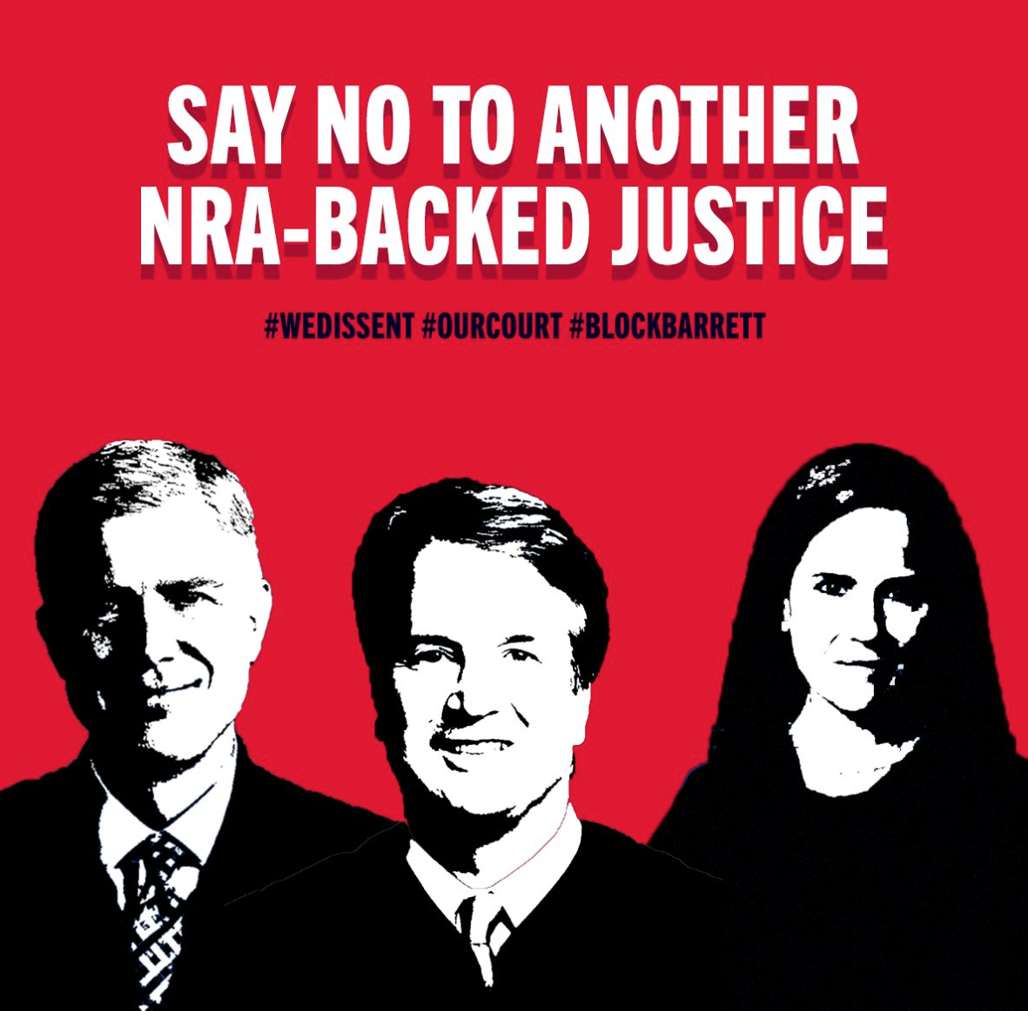
Every day, 100 people are shot and killed. 40,000 are killed each year. But Judge Barrett would rule to gut both our gun safety laws and our access to healthcare. We don't need a reckless, undemocratic nominee who threatens our livelihoods! #WeDissent #BlockBarrett
(b) Predicted Image: 0.684
(c) Predicted Image: 0.674
(a) Actual Tweet Image
(d) Predicted Image: 0.330
(e) Predicted Image: 0.326

Slide 19
The picture posted with the text say #Gunviolence has serious and lasting social and emotional impacts on those who directly and indirectly experience it, a new study by UCD Firearm Violence Research Center @UCDavisHealth and @UCDavisEM found health.ucdavis.edu/vprp/UCFC/

Slide 20
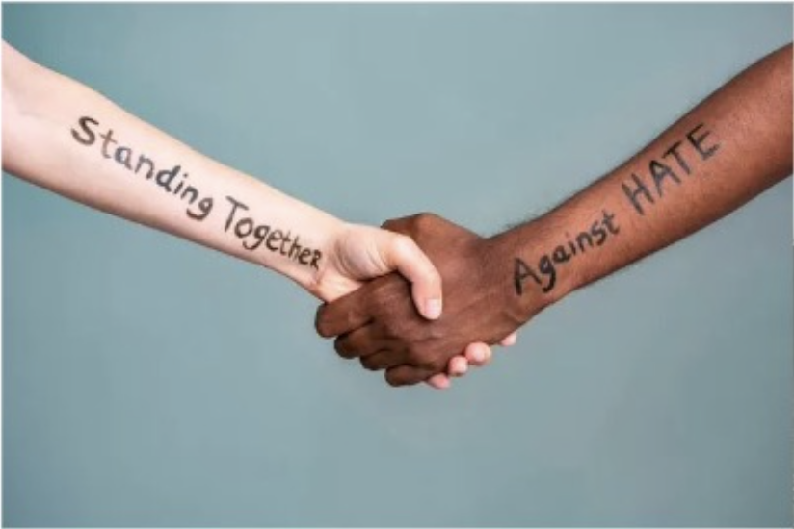

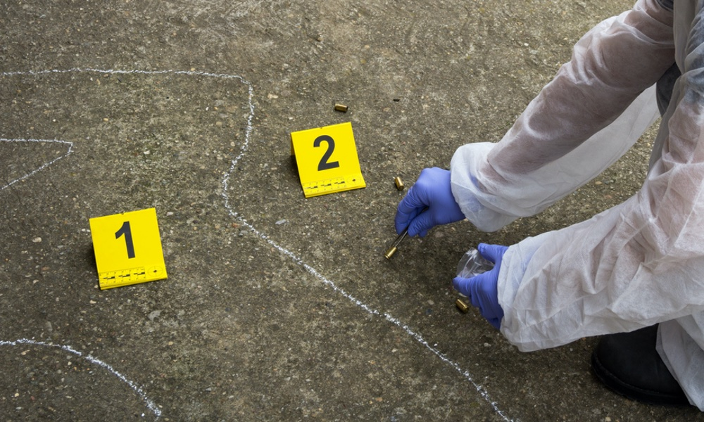
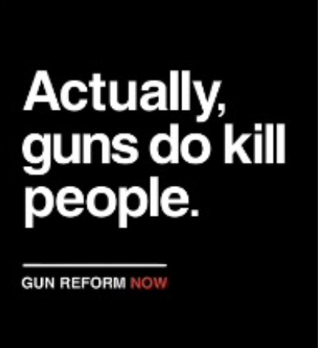
A: Togetherness B: No
A: Sadness; B: No
A: Sadness & Anxiety; B: No
A: Fear & urgency; B: No

Slide 21
A: Togetherness; B: No
A: Sadness; B: No
A: Sadness & Anxiety; B: No
A: Fear & urgency; B: No

Slide 22
Stance:
Positive?
Negative?
Neutral?
Non-relevant?
Image Content Types
Stance: negative
Persuasiveness Score: 2.0
Content Type: Statistics
Persuasion Mode: logos
Pos/Neg
Persuasiveness Score Improvement
> 𝛾
Persuasion Mode

Slide 23
(a)
(b)
(c)
Category Percentage in each

Slide 25
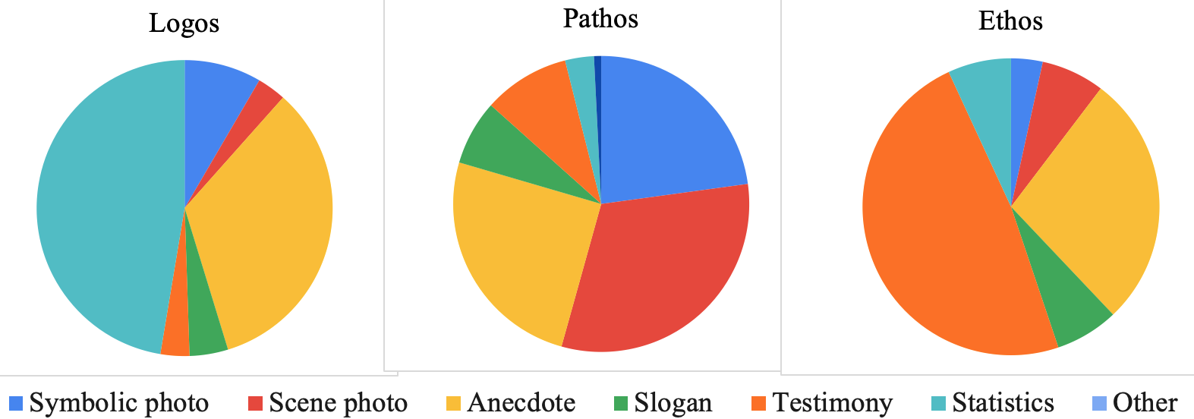

Slide 26
